Slide 1
CARDIAC ACTION POTENTIAL

Slide 2
ACTION POTENTIAL IS the change in electrical potential associated with the passage of an impulse along the membrane of a muscle cell or nerve cell.
In the neuron an action potential produces the nerve impulse, and in the muscle cell it produces the contraction required for all movement.

Slide 3
Action potential in the heart are generated intrinsically or within the heart because of the intrinsic conducting system. Thus, the heart can pump independent of the nervous system

Slide 4
An electrical potential difference exists across the membrane of all living cells with the inside being negative in relation to the outside.
This potential difference is called membrane potential as ions arrange themselves along the outer and inner surfaces of the cell membrane. At resting state of the cell, the membrane potential is called resting membrane potential (RMP). RMP is also called transmembrane potential.

Slide 5
RMP of important excitable tissues.
Tissue/Cell RMP (mV)
Neuron –70
Skeletal muscle –90
Cardiac muscle –90
When the CELL is stimulated, membrane potential changes and inside of the cell becomes positive due to depolarization. The membrane potential during this state of activation is called action potential.

Slide 6
ACTION POTENTIALS IN CARDIAC TISSUES
Normally, two types of action potentials are seen in the heart: the slow response action potential and the fast response action potential. The fast response action potential occurs in the atrial and ventricular muscles and Purkinje fibers, and the slow response action potential occurs in nodal tissues (SA and AV nodes). However, action potential vary from slow to fast type in different tissues of the heart.

Slide 7
Phases and Ionic Basis
Typically five phases (phases 0–4) are observed in a fast response action potential as recorded from ventricular muscle fibers
Phase 0
This is the phase of rapid depolarization and overshoot. As soon as the membrane potential reaches threshold, rapid depolarization (a steep rise in the spike) occurs.
This is due to sudden increase in the permeability of the membrane to sodium ions, which occurs due to hundred fold opening of voltage-gated sodium channels.
2. The sodium ions enter rapidly into the myocardial cells.

Slide 8
3. In fact, immediately above the threshold level of the membrane potential, initially activated sodium channels activate other sodium channels (autoactivation) that results in manifold opening of the channels.

Slide 9
Phase 1
This is the phase of initial rapid repolarization.
This phase of partial repolarization is due to closure of sodium channels (cessation of sodium influx).
2. Opening of outward transient rectifying K+ channel that causes transient outflux of K+ also partly contributes.
3. This K+ current is activated by depolarization and is rapidly inactivated

Slide 10
Phase 2
This is known as plateau phase as the action potential in this phase remains in a state of sustained depolarization.
1. This phase is due to sustained increased permeability of the membrane to calcium ions (through slowly opening calcium channels) that results in slow calcium influx, which occurs due to slower but prolonged opening of voltage-gated calcium channels.
2. Efflux of potassium ions contributes to maintain sustained depolarization.
3. The plateau phase is of much lesser duration in atrial muscle than the ventricular muscles.

Slide 11
Phase 3
This is the phase of final repolarization.
1. This occurs due to cessation of calcium influx (closure of calcium channels) and increased membrane permeability to potassium (increased potassium efflux).
This phase is mainly due to opening of outward delayed rectifying K+ channels (IKs)

Slide 12
Phase 4
This is the phase of restoration of membrane potential.
The membrane permeability to K+ is restored towards resting value
2. Opening of inward rectifying K+ channels (IKr) contributes to maintain the restored membrane potential
3. The relative increase in permeability to K+ drives the membrane potential towards the equilibrium potential

Slide 13
After the initial spike, the membrane remains depolarized for about 0.2 second, exhibiting a plateau, followed at the end of the plateau by abrupt repolarization. The presence of this plateau in the action potential causes ventricular contraction to last as much as 15 times as long in cardiac muscle as in skeletal muscle.

Slide 14
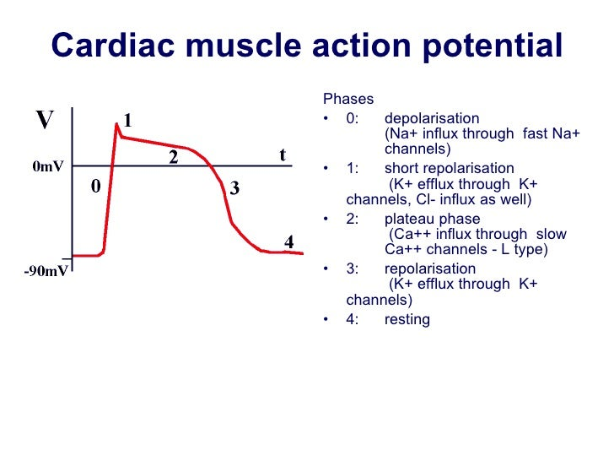

Slide 15
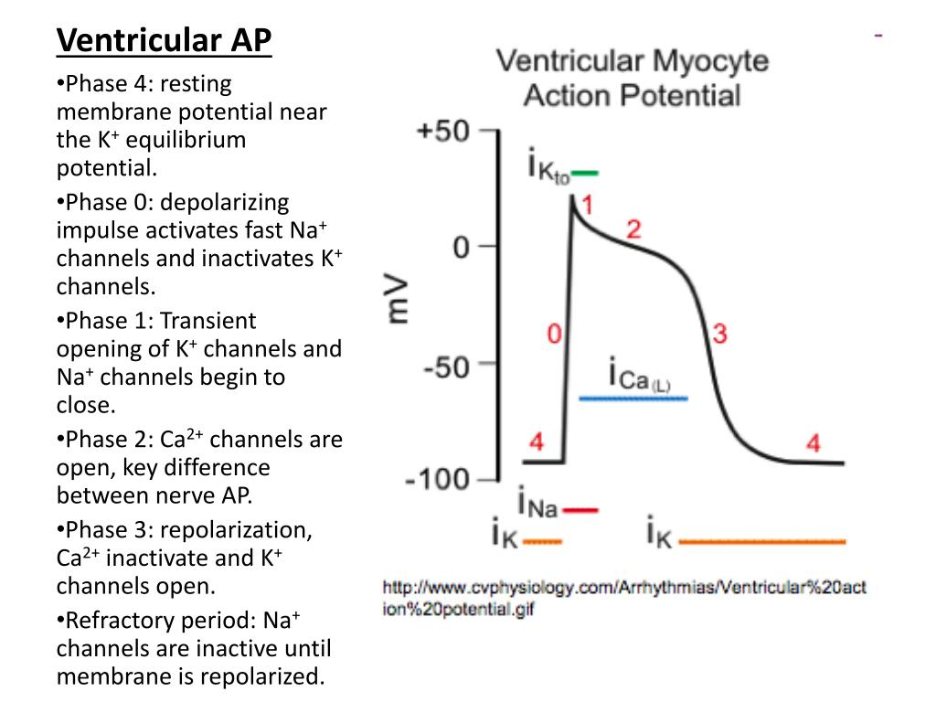

Slide 16
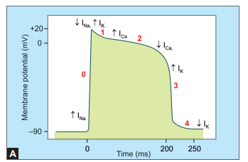

Slide 17
Slow Response Action Potential
This type of action potential is seen in nodal tissues (SA and AV nodes), AV junctional tissue, and ischemic or injured myocardium

Slide 18
Phases and Ionic Basis
Slow response action potential consists mainly of three components the phase 0 (depolarization or slow rising upstroke), phase 3 (phase of repolarization), and phase 4 (phase of slow depolarization). Phases 1 and 2 are usually absent in this type of action potential. In SA node in the phase 4, instead of restoration of the mem‑ brane potential, slow depolarization occurs

Slide 19
Phase 0
It occurs due to the opening of calcium channels.
This phase is less steep in comparison to fast response action potential.
2. The depolarization is mainly due to influx of calcium ions through the long acting calcium channels (L-calcium channels).
3. Therefore, depolarization wave rises slowly
Phase 3
This phase is due to closure of calcium channels and opening of the potassium channels (increased potassium efflux).

Slide 20
Phase 4
This is the phase of slow diastolic depolarization.
1. The early part of this phase is due to the closure of potassium channels (decreased potassium conductance).
2. Later part is due to opening of transient calcium channels (T-calcium channels). Calcium sparks (release of calcium locally from sarcoplasmic reticulum) also contributes

Slide 21
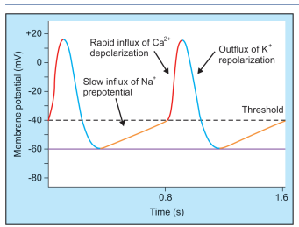

Slide 22
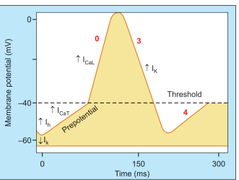

Slide 23
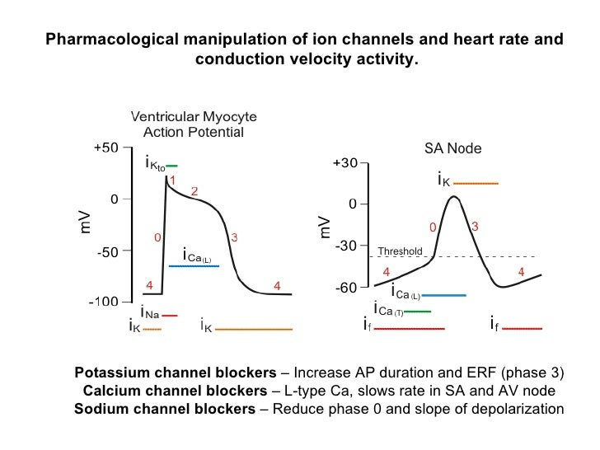

Slide 24
